Slide 1
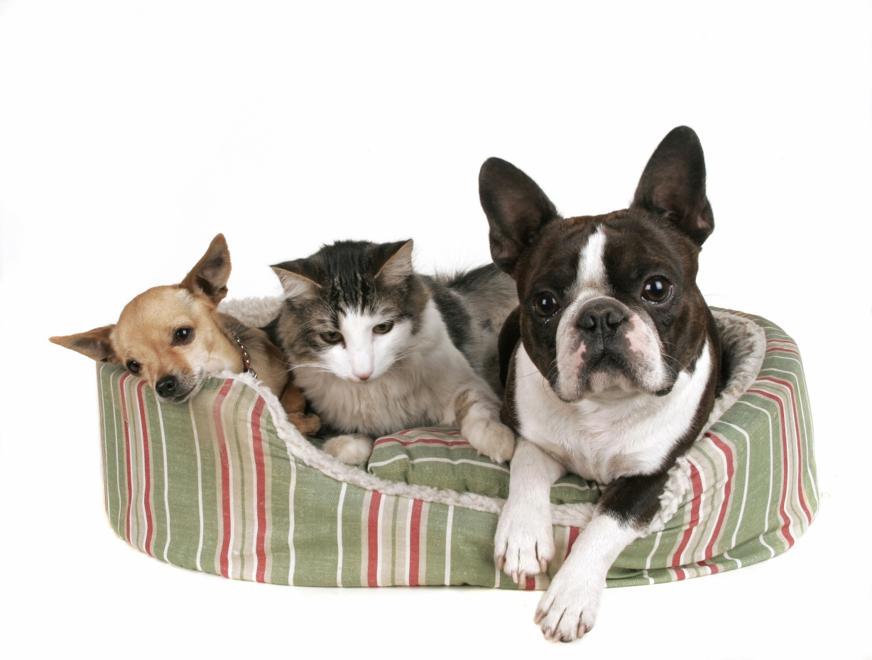
Exercise 3: Cats and Dogs

Slide 2
Exercise 3: Cats and Dogs
The “Cats and Dogs” database has one table with the following information:
Customer name
Number of cats owned
Number of dogs owned
Write a SQL script to create the database and populate it with a few example customers.
Create “Customer.java” and “CustomerDAO.java”.
Create “CustomerDAOTest.java” to JUnit test the DAO.
Write a program to extract the following information from the database:
List of customers with only cats or only dogs (not both)
List of customers with more than six cats
List of customers with more than ten pets
Notes:
Not too ruff
Won’t hurt my felines.
Getters and Setters (not the Irish kind)
No need to Pause between them

